Slide 1
Third Party and Supply Chain Best Practices
The Compliance Collective
JUNE 18, 2026
Speakers: Jamie Schafer, Mason Ji, Sydney Veatch
Guest speaker: Andris Ivanovs, Ashurst LLP

Slide 2

The Compliance Collective
This webinar is a part of our monthly webinar series, “The Compliance Collective.”
The webinar series is hosted by a team of cross-disciplinary Perkins Coie lawyers who provide a monthly overview and discussion forum on a critical hot topic in ethics and compliance. Each topic provides a look at emerging issues and offers creative solutions to potential compliance problems.
The webinar is hosted every third Thursday at the same time each month: 10:00 a.m. PT/12:00 p.m. CT/1:00 p.m. ET.
Sign up on our website to receive invitations to our future webinars!

Slide 3




Agenda
1. How Third Parties Create Legal & Commercial Risk
2. Enforcement & Commercial Impact Examples
Jamie Schafer
Mason Ji
partner
Associate
Perkins Coie LLP
Perkins Coie LLP
3. Compliance Design & Diligence Best Practices
JSchafer@perkinscoie.com
MJi@perkinscoie.com
4. Q&A
Sydney Veatch
Andris Ivanovs
Associate
Partner
Perkins Coie LLP
Ashurst LLP
SVeatch@perkinscoie.com
Andris.Ivanovs@ashurst.com

Slide 4

How Third Parties Create
Legal & Commercial Risk

Slide 5
Anti-Corruption Risk Vectors
DISTRIBUTORS/RESELLERS
GOVERNMENT INTERMEDIARIES
Bribery on company's behalf or attributed to the company on an agency theory
“Facilitation payments” to secure permits & customs
May win business through corrupt practices
Law firms, lobbyists, local partners/agents
Channel payments to officials
"Anything of value" for favorable treatment
Key Risk: FCPA & UK Bribery Act liability may even without knowledge of the bribe (e.g. willful blindness; agency liability)

Slide 6
Sanctions Exposure Through Third Parties
Key Risk: Sanctions regimes operate on a strict liability basis—liability can attach regardless of intent or knowledge.
Ownership & Counterparty Risk
Governance & Compliance Gaps
Ignoring Red Flags / Inadequate Escalation
Contractual Weaknesses
Ownership or Control by Designated Parties
Obscured / Layered Beneficial Ownership
Transaction Pathways
Facilitation / Indirect Dealing
Non-Transparent Payment Chains
Diversion to Sanctioned Jurisdictions
Technology & Service Enablement
Cloud / SaaS Access & Support
API Integrations Enabling Prohibited Access
Lack of Ongoing Monitoring
Key Third Parties Raising Risks:
Any third party can raise sanctions risks
Whether or not you have a direct or indirect relationship (e.g. full supply chain)
Whether or not or goods change hands (e.g. negotiations; receipt or provision of “services”)
Notes:
TALKING POINTS:
- OFAC enforces on a strict liability basis — intent is irrelevant to whether a violation occurred
- 50% Rule: entity owned 50%+ by sanctioned person is itself sanctioned, even if not listed
-Increase facilitation Risks is acute for distributors in jurisdictions bordering/near sanctioned countries (ie a distributor selling products he intends to go to Russia)
- Technology companies face unique challenges with IP-based geolocation and VPN circumvention

Slide 7
Export Control Risks Through Third Parties
END-USE RISK
CLASSIFICATION &
LICENSING GAPS
SCREENING &
RED FLAGS
Transshipment through third countries to sanctioned destinations
False end-use certificates from intermediaries
Re-export or re-transfer without authorization
Third parties misclassifying items to avoid license requirements
Failure to flow down license conditions
Unauthorized deemed exports
Inadequate screening of downstream customers
Incomplete Entity List and Denied Persons screening of partners
Key Third Parties Raising Risks
Distributors/Resellers
Customers/End Users
Contractors/Intermediaries with access to goods or technology
Key Risk: Export violations carry strict liability—companies are responsible for ensuring items reach authorized end-users regardless of intermediary involvement.

Slide 8
Tariff & Trade Remedy Risks Through Third Parties
1
2
3
Fraud (Origin, Valuation)
Supply Chain
Opacity
Contractual &
Compliance Gaps
• Third-party suppliers misrepresenting country of origin
• Transshipment schemes to circumvent Section 301 tariffs
• Undervaluation of goods on invoices
• Lack of visibility into sub-tier supplier locations
• Inability to verify substantial transformation claims
• Opaque bill-of-materials sourcing across multiple jurisdictions
• Failure to include tariff compliance representations in supplier agreements
• No audit rights over supplier trade documentation
• Inadequate duty drawback and FTZ tracking across partners
Key Risk: Tariff evasion by third parties can trigger severe penalties including anti-dumping duties, countervailing duties, and criminal liability for the importer of record.
Key Third Parties Raising Risks
Suppliers (and sub-suppliers)

Slide 9
Forced Labor Risks Through Third Parties
Supply Chain
Traceability
• Sub-tier suppliers in high-risk regions (e.g., Xinjiang)
• Inability to map raw material sourcing to specific facilities
• Co-mingling of compliant and non-compliant inputs
Key Risk:
Under the UFLPA and new Section 301 investigations, goods are presumed made with forced labor unless the importer affirmatively proves otherwise. Ignorance is not a defense.
Forced Labor
Risk Through
Third Parties
Third-Party
Conduct
• Suppliers using labor brokers with exploitative practices
• Subcontracting to unauthorized facilities
• Withholding wages or documents by intermediaries
Governance &
Documentation
• Lack of supplier codes of conduct addressing forced labor
• Insufficient audit mechanisms for labor conditions
• Absence of grievance and remediation processes
Key Third Parties Raising Risks
Suppliers (and sub-suppliers)

Slide 10
Reputational Impacts
Third Party Misconduct
Media Coverage
Brand Damage
Investor Pressure
Commercial Loss
Key Point: Even absent legal liability, third parties can harm to your entity
Notes:
VPN circumvention

Slide 11
Other Areas of Potential Third-Party Risk to Consider
Consider leveraging third party diligence/monitoring procedures to cover other key areas, where appropriate :
Cyber Security/Data Privacy (e.g. technology vendors/service providers with access to customer or employee data)
Environmental Harm (e.g. certain suppliers and waste disposal companies)
Lobbying/Political Law Compliance (e.g. lobbyists, government affairs, law firms and local partners)

Slide 12
Enforcement & Commercial
Impact Examples

Slide 13

U.S. DOJ & SEC| FCPA | SAP, SE (2024)
$222M
CONDUCT
Publicly traded global software company employed third party intermediaries and consultants to pay bribes, make political contributions, and provide luxury goods to foreign officials to obtain contracts Business partners and consultants made corrupt payments to airline executives and government officials to win aircraft orders in multiple countries.
$119M
Criminal Penalty
$103M
Forfeiture
3 Year
DPA
TAKEAWAY: A company cannot shield itself from liability by channeling corrupt acts through third-party intermediaries.
Notes:
VPN circumvention

Slide 14
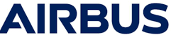
UK SFO / France PNF / US DOJ | Airbus SE (2020)
$3.9B
CONDUCT
French aircraft manufacturer made corrupt payments to consultants and business partners, who then used the funds to bribe airline executives and government officials.
Largest Global Anti-Corruption Resolution
£991M
UK
€2.1B
France
$527M
U.S.
TAKEAWAY: Section 7 "failure to prevent" requires proving "adequate procedures" to prevent third parties from carrying out corrupt conduct, including through due diilgence.
Notes:
Note that the US and France penalties included export violation penalties

Slide 15
OFSI | Russia Sanctions | Apple Distribution International (2026)
€390,000
CONDUCT
ADI, an Irish subsidiary of Apple Inc, instructed a UK bank to make two payments totalling £635,619 to Okko LLC, a Russian streaming platform wholly owned by a designated person. The breach was attributed to an inadequate due diligence model that relied on self-certification and third-party vendors, which was insufficient. OFSI found ADI had no intent, knowledge, or cause to suspect a breach — but imposed a penalty regardless under the strict liability regime.
€
€2.1B
France
$527M
U.S.
TAKEAWAY: Ultimate responsibility for sanctions compliance rests with the paying entity, even where screening is outsourced to third parties. Non-UK companies using UK banks create a UK nexus and face UK enforcement.
Notes:
ADI (Irish subsidiary of Apple Inc) made two payments totalling £635,619 from a UK bank account to Okko LLC (Russian streaming platform) under an App Store revenue-sharing arrangement
Okko was wholly owned by designated person JSC New Opportunities.
Payment A instructed 6 June 2022 (released 30 June, the day after designation); Payment B instructed 30 June 2022 (released 28 July). ADI failed to cancel either
Key aggravating factors:
ADI’s onboarding of Russian app developers relied on self-certification and third-party due diligence vendors — insufficiently calibrated to heightened Russia risk post-February 2022
Third-party vendors failed to identify the Sberbank → New Opportunities ownership change, despite multiple open-source media articles clearly indicating the transfer
OFSI determined ADI should have affirmatively requested ownership information from Russian counterparties rather than relying on passive screening
Compliance takeaways:
UK nexus: UK sanctions apply to any conduct in the UK, including non-UK firms using UK banks. ADI was liable because it used a UK bank account
Strict liability : OFSI found ADI had no intent, knowledge, or cause to suspect a breach but imposed a penalty anyway. Compliance programme deficiencies, not subjective awareness, drive enforcement
Delegation does not shift responsibility: Firms retain ultimate responsibility for sanctions compliance even where they rely on third-party screening providers. Vendor failures are treated as the firm’s own shortcomings
Ongoing screening expected: Payment B was instructed the day after designation and released a month later. OFSI effectively expects firms to re-screen between instruction and release, and cancel where necessary
Voluntary disclosure rewarded: Baseline £600,000 (statutory max £1m); 35% discount for voluntary disclosure and settlement. Case assessed as “serious” (not “most serious”)
Settlement scheme:
First use of OFSI’s settlement scheme (introduced 9 February 2026). Resolved under transitional arrangements — standalone 20% settlement discount did not apply, but OFSI reflected settlement in the voluntary disclosure credit

Slide 16
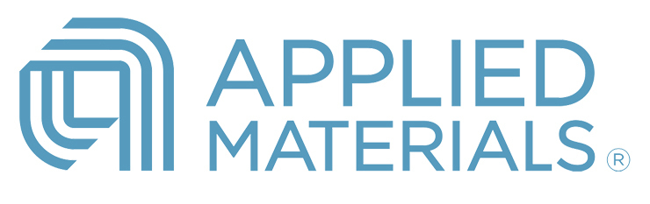
BIS | Export Controls | Applied Materials, Inc. (2026)
$252M
BIS's 2nd-highest penalty ever (maximum by statute = 2x transaction value)
2020
SMIC ADDED TO
ENTITY LIST
BIS cites ties to Chinese
military-industrial complex
2021
DUAL-BUILD
WORKAROUND
Partial assembly in U.S.,
ship to Korea claiming
"substantial transformation"
2021–2022
56 UNLICENSED
REEXPORTS
54 reexports + 2 attempted
from Korea to SMIC
($126M in ion implanters)
2026
BIS SETTLEMENT
$252M penalty, mandatory
compliance audits, staff
terminated
THIRD-PARTY RISK LESSON:
A foreign subsidiary used as a pass-through does not transform U.S.-origin items into foreign-made goods. The EAR has no "substantial transformation" test — companies cannot use subsidiaries or intermediaries to circumvent export licensing requirements.
• 56 violations of the EAR involving $126M in restricted semiconductor manufacturing equipment (ion implanters to SMIC)
• DOJ and SEC closed related investigations without action following the settlement
• BIS: "U.S.-origin items remain subject to EAR regardless of foreign assembly"

Slide 17
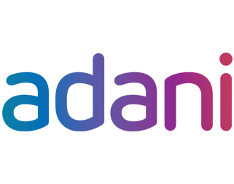
OFAC | Iran Sanctions | Adani Enterprises Limited (2026)
$275M
OFAC Settlement | 32 Apparent Violations | $192M in U.S. Dollar Payments
THE THIRD-PARTY DECEPTION
RED FLAGS IGNORED
IRAN
True origin of LPG cargos
!
Third-party warnings that cargos may be Iranian-origin received on at least 4 occasions
!
Below-market pricing inconsistent with claimed Omani/Iraqi origin
DUBAI SUPPLIER (Intermediary)
Purporting to supply Omani/Iraqi LPG
Affiliate previously designated by OFAC (Mar 2023)
!
AIS manipulation: spoofing and prolonged unexplained dark periods on vessels
!
Uneconomic vessel movements, frequent name/ownership/flag changes
AEL (India)
35 cargos of Iranian-origin LPG (Nov 2023 - Jun 2025)
USD payments routed through U.S. financial institutions
!
Falsified certificates of origin — nonsequential numbering, outdated templates
THIRD-PARTY RISK LESSON:
Relying solely on counterparty documentation and SDN screening is insufficient. Non-U.S. companies using the U.S. financial system must conduct enhanced due diligence on intermediaries, including verifying cargo origin, monitoring vessel behavior, and investigating third-party allegations — not dismissing them as competitor tactics.
!
Bank stopped payment due to “internal policy” — supplier redirected to new account

Slide 18

Forced Labour | Supply Chain & Subsidiary Liability
Paris Judicial Court | French Duty of Vigilance Law | Yves Rocher Group (2026)
UK High Court | Forced Labour | Dyson (2026 — settled pre-trial)
CONDUCT
CONDUCT
Yves Rocher's Turkish subsidiary dismissed over 130 workers (2018–2019) after they joined a trade union to challenge poor conditions, discrimination, and sexual violence. The court found Yves Rocher excluded the subsidiary from its vigilance plan and failed to assess trade union freedom risks, despite having access to information indicating those risks.
Migrant workers alleged forced labour at two independent Malaysian factories used by Dyson between 2011 and 2022. Dyson was sued for the conduct of the third-party suppliers in negligence and unjust enrichment. UK Supreme Court refused Dyson's attempt to move the case to Malaysia. Settled March 2026; Dyson denies liability.
€8,000 per worker (6 workers)
€40,000 to trade union
TAKEAWAY: Formal compliance is not enough. Having a vigilance plan that fails to substantively identify known risks is itself a fault.
TAKEAWAY: A company can face liability for forced labour by third-party suppliers where it exercises significant control over supply chain standards.
Notes:
Yves Rocher Group
First-ever damages awarded under the French Duty of Vigilance Law (12 March 2026)
Yves Rocher’s Turkish subsidiary (Kosan Kozmetik / Flormar factory) dismissed over 130 workers (2018–2019) after they joined Petrol-İş trade union
Workers had organised against poor conditions, discrimination against women, and sexual violence
Court found Yves Rocher excluded the subsidiary from its vigilance plan and failed to assess trade union freedom risks — despite having information indicating those risks
Misconduct was at a subsidiary (not independent third party) — but the law equally covers suppliers and subcontractors
Extraterritoriality confirmed: law held to be a “loi de police” under Rome II — applies to harm outside France; local law cannot displace it
Risk-based prioritisation rejected as defence: court rejected argument that subsidiaries could legitimately be deprioritised where internal warnings existed
Causal link: company’s own acknowledgment it had the power to intervene (action plan in June 2018) was used against it
Best efforts standard confirmed — but failing to act on known risk indicators is sufficient to establish fault
Damages: €8,000 each to 6 workers; €40,000 to Petrol-İş; €1 symbolic to Sherpa and ActionAid France (72 other claimants barred by prior settlement)
Key takeaway: Formal compliance is not enough — vigilance plans must substantively identify and address concrete risks. Similar liability could attach for failures to monitor third-party suppliers and subcontractors.
Dyson
24 migrant workers from Nepal and Bangladesh sued Dyson in the English High Court in 2022
Alleged forced labour at two independent Malaysian factories
No ownership or corporate group connection between Dyson and the factories — purely commercial supply chain relationship
Allegations included passport confiscation, restricted movement, excessive hours, hazardous conditions, unlawful detention, and assault
Many workers were coercively recruited and trafficked
Legal basis:
Negligence — Dyson exercised significant control over supplier standards and knew or ought to have known of forced labour risks
Unjust enrichment — Dyson profited from reduced production costs driven by exploitation (novel argument in supply chain litigation)
UK Supreme Court refused Dyson's forum challenge (May 2025) — confirmed English courts will hear supply chain forced labour claims against UK companies
January 2026: High Court confirmed Dyson could face 100+ additional claims
Parties settled March 2026; Dyson denies liability
Key takeaway: A company can face liability for forced labour by third-party suppliers — not just subsidiaries — where it exercises significant control over supply chain standards. Commercial relationships alone may establish a duty of care.

Slide 19
DOJ’s Trade Enforcement Apparatus: New Third-Party Risk Landscape
TRADE TASKFORCE
• Cross-agency task force: DOJ Civil Division, Criminal Division, and DHS
• Uses collections actions, FCA actions, and criminal prosecutions
• Landmark: $549.5M settlement (Perfectus Aluminum) in May 2026
THIRD-PARTY RISK IMPLICATIONS
• Transshipment and relabeling schemes through intermediaries in Southeast Asia
• Misclassification and undervaluation by third-party suppliers
• Supply chains with “tentacles throughout Southeast Asia and other global supply chains” from China
• Private FCA suits allow competitors to bring claims
• Congressional investigations expected to intensify
NATIONAL FRAUD ENFORCEMENT DIVISION
• Created April 2026 to target fraud against the federal government
• Incorporates former Market, Government and Consumer (MGC) Fraud unit personnel
• Works alongside Trade Taskforce on trade fraud matters
EXPANDING LEGAL TOOLS
• False Claims Act: civil and qui tam actions for customs fraud
• UFLPA: blocking imports tied to forced labor
• TVPA/TVPRA: trafficking-related enforcement
• Traditional AD/CVD and customs enforcement
Both civil and criminal trade fraud prosecutions are expected to increase — importers face liability for their third parties’ evasion schemes.

Slide 20
Compliance Design &
Diligence Best Practices

Slide 21
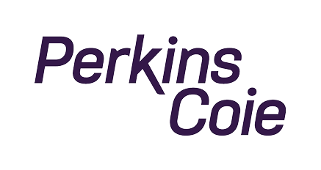
Regulatory Evaluation Framework
1
2
3
Well
Designed?
Adequately
Resourced?
Works in
Practice?
FIVE CORE ELEMENTS
Management
Commitment
Risk
Assessment
Internal
Controls
Testing &
Auditing
Training
If not documented, regulators assume non-compliance
Confidential © Perkins Coie LLP
Notes:
First section From the DOJ Guidance
Elements from Framework for OFAC/BUS Guidance

Slide 22
Risk Assessment Foundations
Commercial Understanding
Risk Identification
Risk Profiling
Periodic Review
Re-asses after operational or other changes that could impact the risk profile
Define the entity’s specific risk profile and mitigating factors
Identify and assess risk factors across the organization
Understand the business from a commercial perspective and identify the appropriate level of scrutiny and resources
Control Identification
Identify and implement appropriate controls to mitigate risk that are feasible and appropriate to the entity’s operations
Key Point: Risk assessments are entity specific, there is no one-size-fits-all risk profile
Notes:
TALKING POINTS:
- These expectations are reflected in the DOJ ECCP but are broadly applicable

Slide 23
Risk Tiering Third Parties
HIGH RISK
Enhanced Due Diligence
RISK FACTORS
Country / Jurisdiction
Industry Sector
MEDIUM RISK
Standard Due Diligence
Transaction Type
Value of Engagement
LOW RISK
Streamlined Due Diligence
Government Proximity
Nature of Services
Risk tiering must be documented and defensible

Slide 24
Elements of Third-Party Due Diligence
Background & History
Questionaries
Vetting & Approvals
Transactional Documentation/ Certifications
Screening
Ongoing Monitoring
Training

Slide 25
Ongoing Monitoring vs. Onboarding Diligence
Onboarding
Active
Triggers
Initial screening and diligence
Renewal
Re-evaluation at renewal or on a set timeline
Red flags, adverse media, ownership changes, etc
Periodic rescreening and ongoing monitoring
Point in Time
Onboarding & Renewal
Continuous Monitoring
Rescreening, monitoring, red flag reviews, etc.
Notes:
TALKING POINTS:
- Onboarding diligence is table stakes — the real test is what happens after onboarding
- Third-party risk profiles change: ownership changes, new sanctions designations, adverse media
- Continuous/periodic rescreening catches changes that point-in-time diligence cannot
- Contract renewals are a critical control point — treat them as fresh diligence opportunities
- Regulators want to see that red flags trigger action, not just documentation

Slide 26
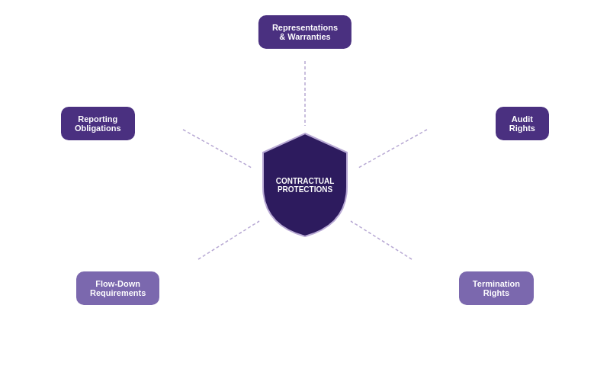
Contractual Protections

Slide 27
General Best Practices
CENTRALIZE
INTEGRATE
TRAIN
Use a single system of record for all third parties
Embed diligence into procurement workflows
Front-line teams must know the red flags to watch for and how to escalate
AUTOMATE
DOCUMENT
TEST & AUDIT
Screening, monitoring & workflow tools
If something is not documented, it didn't happen
Conduct periodic audits and simulations
Notes:
Centralization prevents fragmented oversight — commercial teams should not manage third parties in silos
- Integration into existing workflows ensures compliance is not an afterthought but a gate
- Training is critical for commercial teams who interact with third parties daily
- Technology enables scale — manual screening is error-prone and unsustainable
- Documentation is your best defense — regulators cannot credit what they cannot see

Slide 28
“Lessons Learned”
Consider an internal “blacklist” or “red flag list”
Ensure communication across key functions of the company gathering information
  Make sure Sales is included in diligence process
Continuous or 24 hr list-based screening is a best-practice (even brief delays can create significant liabilities)
Choose your screening lists carefully: decide which matter and which do not to cut down on administrative time and focus resources on red flags that matter
Evaluate all available information about the third party (e.g. if you get IP information, screen it; if your sales team meets with the third party, get their input)
Train all personnel in a position to identify and elevate risks (e.g. executive; legal; finance; HR; sales; procurement – but typically NOT engineers, marketing, IT)
CENTRALIZE
INTEGRATE
TRAIN
AUTOMATE
DOCUMENT
TEST & AUDIT
Notes:
Centralization prevents fragmented oversight — commercial teams should not manage third parties in silos
- Integration into existing workflows ensures compliance is not an afterthought but a gate
- Training is critical for commercial teams who interact with third parties daily
- Technology enables scale — manual screening is error-prone and unsustainable
- Documentation is your best defense — regulators cannot credit what they cannot see

Slide 29
Key Policies and Procedures to Consider
POLICIES
PROCEDURES
CODES & CERTIFICATIONS
Sanctions Compliance
Third-Party Diligence & Monitoring
Employee Code of Conduct
Export Compliance
User / Customer KYC Procedures
Third-Party / Supplier Code of Conduct
Anti-Corruption
Employee Compliance Certification
Import Compliance
Third Party / Supplier Compliance Certification
Gifts / Travel / Entertainment
Training
Political & Charitable Contributions
Data Privacy & Security
Notes:
While this looks like a long list, many of these policies can be combined (such as having a sanctions and anti-corruption policy)
Not every entity needs every policy, but we find this to be a good starting Point

Slide 30
CLE Code Word: Diligence

Slide 31
Questions?

