Slide 1
Antitrust and Competition Issues in AI Development and Distribution
April 14, 2026

Slide 2
Agenda
The AI Stack
Current AI-Related Cases
Issues to Date
Themes Across the Various Cases and Issues
The Right Instrument: Competition Law vs. DMA vs. Others

Slide 3
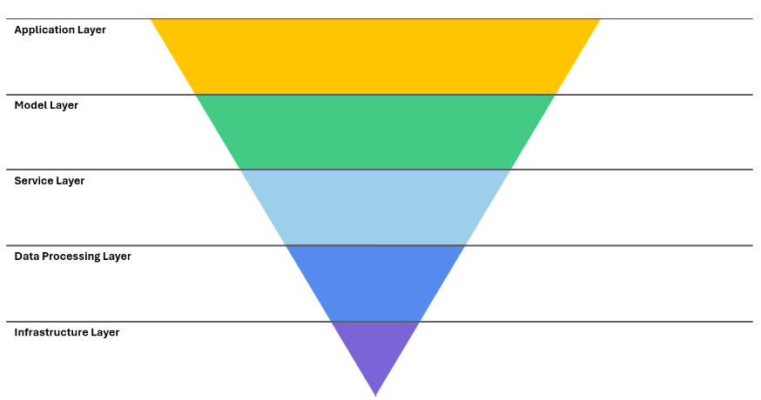
I. The AI Stack

Slide 4
II. Current AI-Related Cases
Competition Law
EC investigation of whether Meta restricts access by competing agentic AI providers to WhatsApp, including IM
Italian Competition Authority (ICA) investigation of whether Meta is tying its AI chatbot to WhatsApp, expanded to include access to WhatsApp’s APIs (ordered interim measures)
EC investigation of whether Google has failed to appropriately compensate publishers and content creators for use of their content (without consent) in AI powered services (AI Overviews and AI Mode) and to train generative AI models using content uploaded to YouTube (without appropriate compensation or consent)
EC investigation of Google AdTech self-preferencing (framed by the EC as algorithmic manipulation). Remedies recently tested
DMA/DMCC Act
Investigation of alleged self-preferencing (Art 6(5) DMA) by Google (includes AI Overviews and AI Mode); DMCC Act designation of Search (including AI Overviews and AI Mode, but not the Gemini AI assistant) and search advertising under the DMCC Act
Investigation of alleged demotion of media publisher content by Google under the site reputation abuse policy (Art 6(12) DMA); Conduct Requirements consultation opened by CMA
Specification proceedings re (i) Gemini access to Android features (Art 6(7) DMA) and (ii) FRAND terms for access to anonymized Search ranking, query, click and view data (including access by AI chatbots) (Art 6(11) DMA)
Notes:
Art 25 DSA re page design
Art 26 DSA about unmarked advertising

Slide 5

III. Issues to Date
Integration of content that has been produced using AI
Integration of an AI assistant/AI agent UI into a CPS/dominant service
Integration of third-party AI assistant/AI agent into a CPS/dominant service
Bundling/tying AI assistants/AI agents with a CPS/dominant service
AI as “engine” in ranking/recommender systems (including self-preferencing)
Denial of third-party access/ interoperability to a CPS/dominant service

Slide 6

IV. Cross-Cutting Content, Data and Traffic Issues
Use of data for model development, training, retraining, tuning, and grounding
Appropriation of content without “appropriate” compensation
Use of publisher data to divert traffic

Slide 7

V. The Right Instrument: Competition Law v. DMA v. Others
Article 102 and DMA are not interchangeable
DMA is narrower than it looks
DMA likely cannot do pricing remedies outside Art 6(12)
But DMA has unique procedural tools
NCA fragmentation is an issue
Open question on whether regulation needs updating

